Slide 1
Wastewater Treatment
Ge Gao, Maithili Gokarn, Walker Grimshaw, Ethan Keller, Caitlin McKinley, Amiel Middelmann, Luke Zhu
Notes:
walker

Slide 2
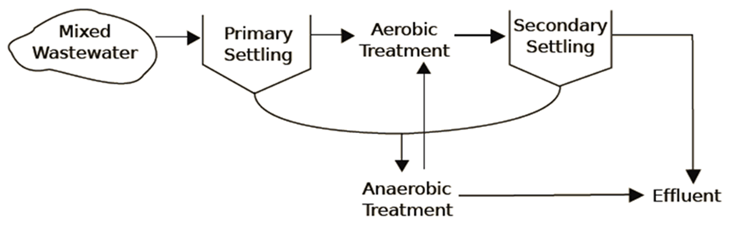
Whole System
Anaerobic Treatment
high strength wastewater
energy neutral
methane production -can run whole treatment plant or components of aerobic treatment plant
Aerobic Treatment
higher efficiency
nutrient removal
more experience
Notes:
walker

Slide 3
Anaerobic Treatment

Slide 4
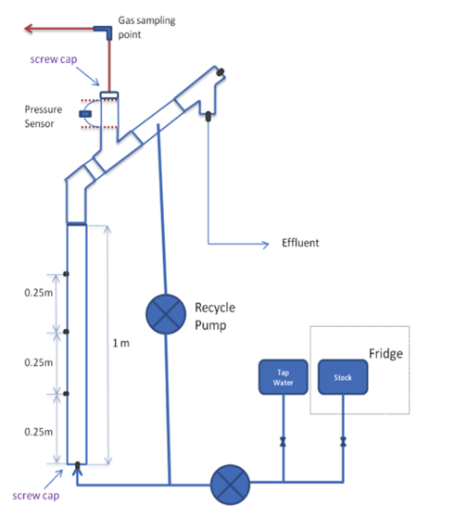
UASB Reactors
(Upflow Anaerobic Sludge Blanket )
Spring 2014
Gas tightness
Inoculation ~ 566 ml of bio-granules
Operation Changes:
• Double HRT
•Reduce pump flow rate to half
•Double strength of wastewater
heating
Data analysis
Notes:
Vicky

Slide 5
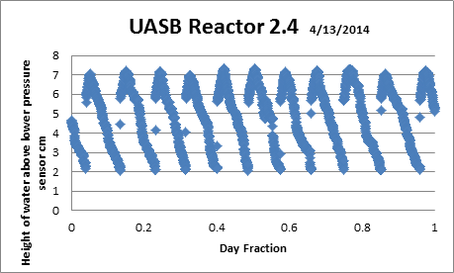
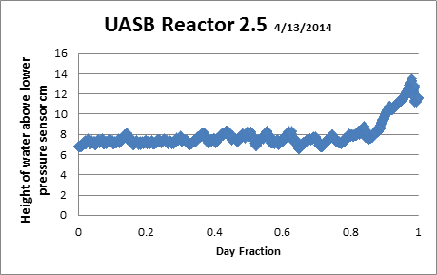
Biogas Production
COD Removal in the form of CH₄ and CO₂ gas production
Notes:
Vicky

Slide 6
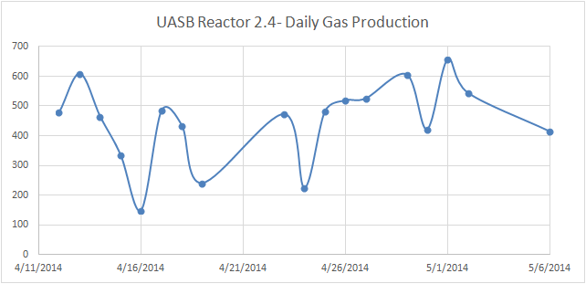
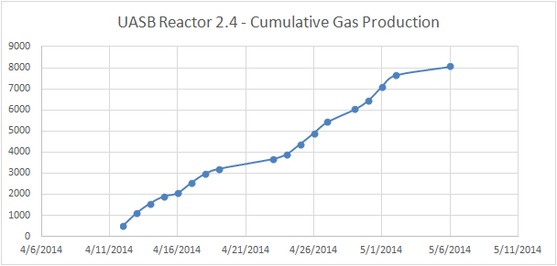
Biogas Production
Notes:
Vicky

Slide 7
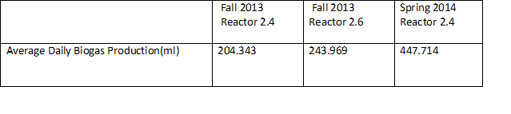
Biogas Production
Average Daily Biogas Production
Notes:
Vicky

Slide 8
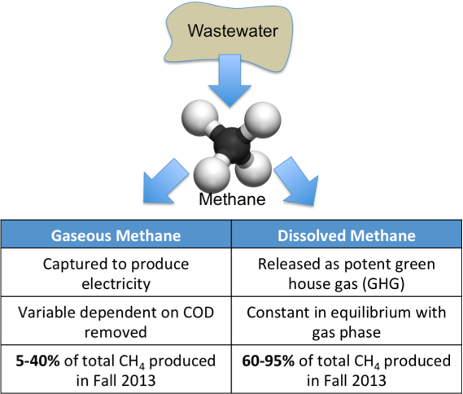
Biogas Fate

Slide 9
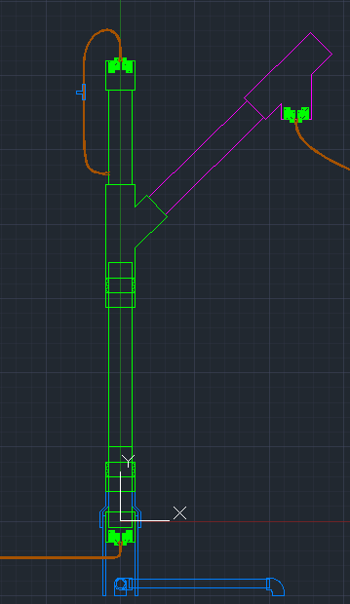
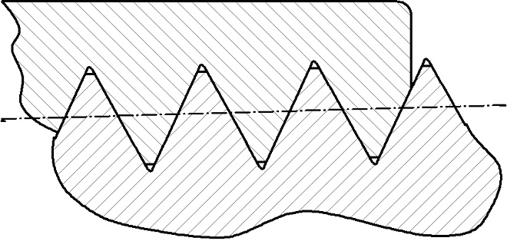
Biogas Fate
Captured and Volume Inferred With Pressure Reading
Through Solenoid
Transfer Over Gas-Liquid Interface at Weir
Bubbles go out Weir
Dissolved In Effluent
Through Cracks and Threads

Slide 10
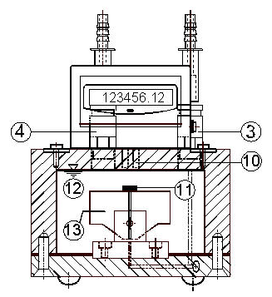
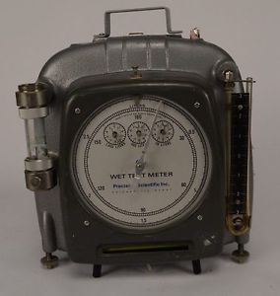
Biogas Collection Solutions
Increase WW Strength
Redundant Gas Collection (Wet Test Meter, Bubble Meter, Bag test)
Additional Collection
Cautious Construction
Raising Temperature
Wet Test Meter
Ritter Bubble Meter

Slide 11
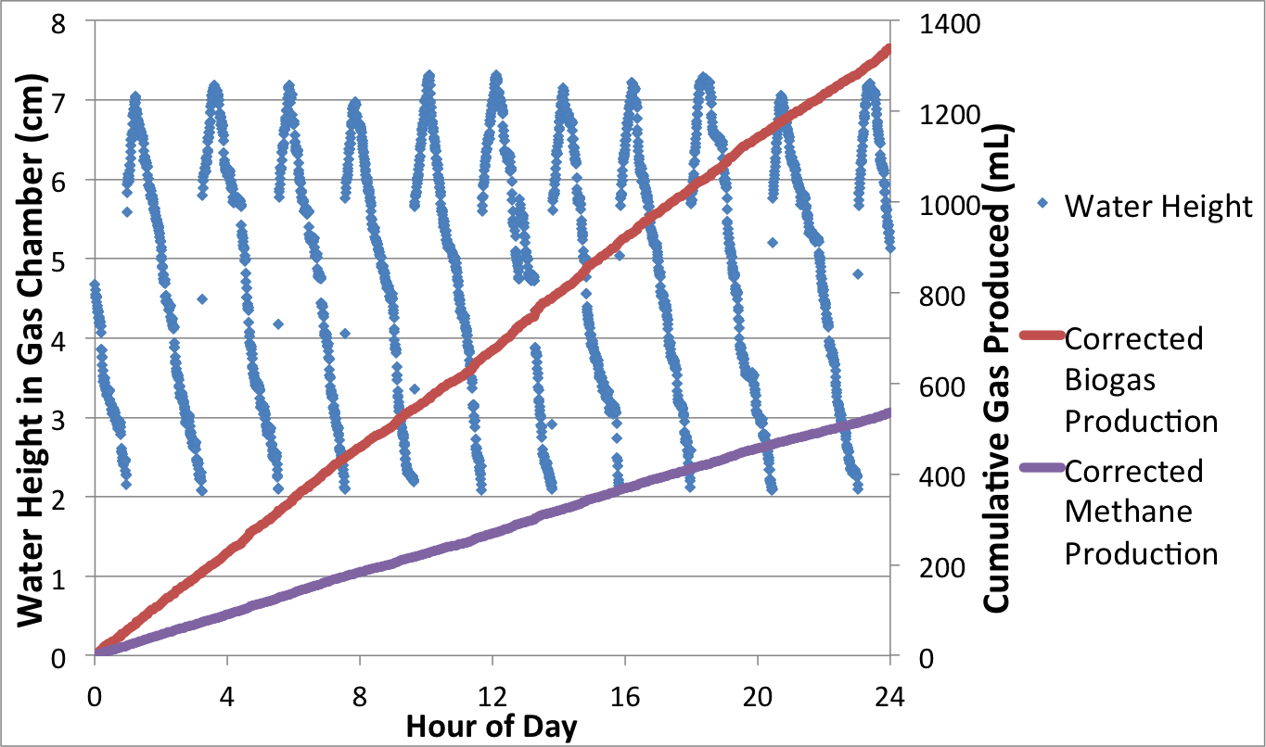
Correcting for gas losses from valve opening
Notes:
Ethan

Slide 12
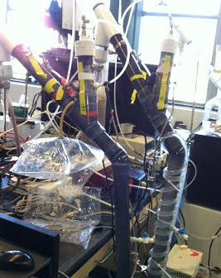
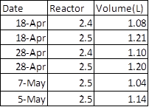
2.4: ~1090 ml biogas per day
2.5: ~1150 ml biogas per day
‘Bag’ Test
Notes:
Caitlin

Slide 13
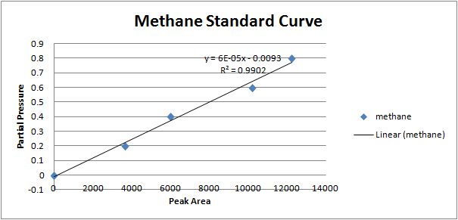
Methane Gas Production
Calculate partial pressure of methane from standard curve equation .
Notes:
Maithili

Slide 14
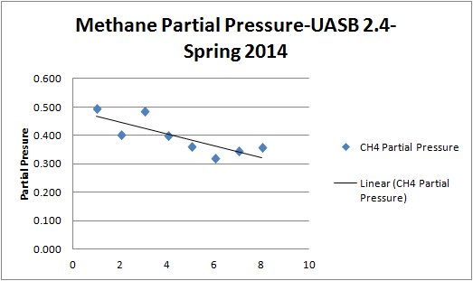
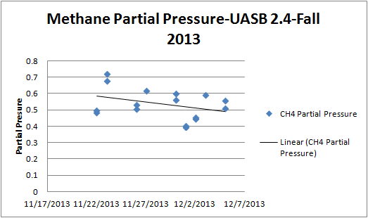
Methane Gas Production
UASB Reactor 2.4
Gas tight from April 12, 2014 to date
Producing methane gas - negative trend, more steep, than Fall 2013
Partial pressure lower than last semester.
Methane lost in effluent?
Notes:
Maithili

Slide 15
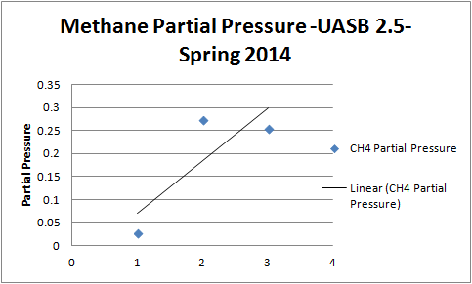
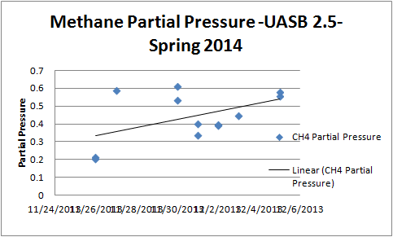
Methane Gas Production
UASB Reactor 2.5
Gas tight past 2 weeks
Producing small amounts of methane
Insufficient data to make conclusion
Notes:
Maithili

Slide 16
Average Daily Methane Gas Production
Methane Gas Production
 | Fall 2013 Reactor 2.4 | Fall 2013 Reactor 2.6 | Spring 2014 Reactor 2.4
Average Daily Methane Production(ml) | 116.82 | 139.477 | 176.623
Notes:
Maithili

Slide 17
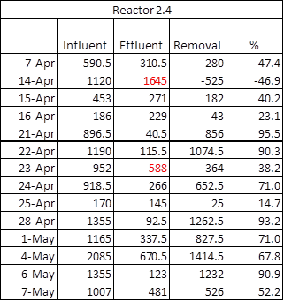
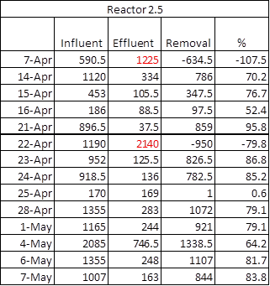
Chemical Oxygen Demand

Slide 18
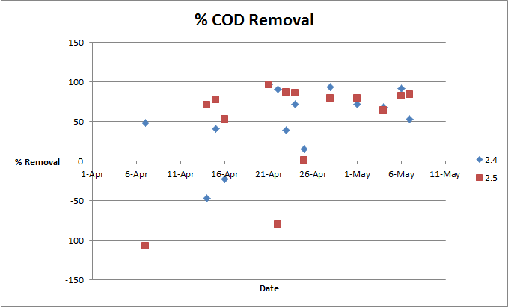
% COD Removal

Slide 19
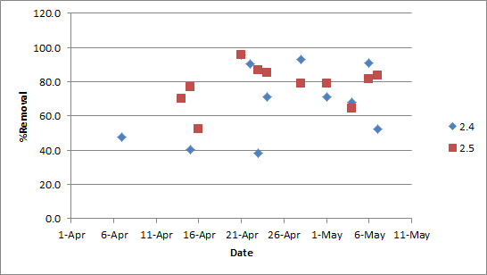
Overall:
2.4 : 68.8%
2.5 : 77.7%
% COD Removal
Heating Begins
2.5 before heating:
77.9 %
2.5 after heating:
77.6%

Slide 20
Reactor Modifications - Heating

Slide 21
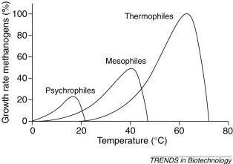
Microbial Growth Rate and Temperature

Slide 22
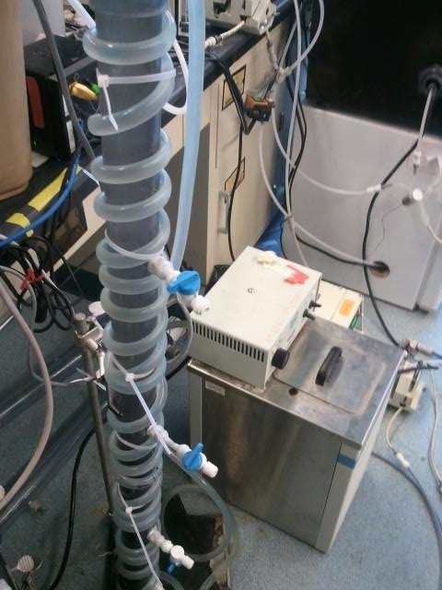
Parameters
Tube L = 19 ft
Tube D = 0.5 in
Number of coils = 22
Bath Temp = 55°C
Reactor Temp = 32°C

Slide 23
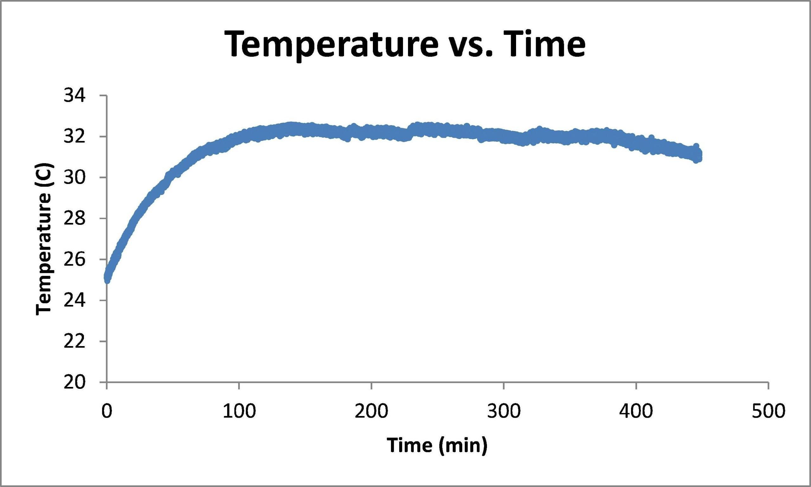
Heating start-up
Two hours to reach steady temperature

Slide 24
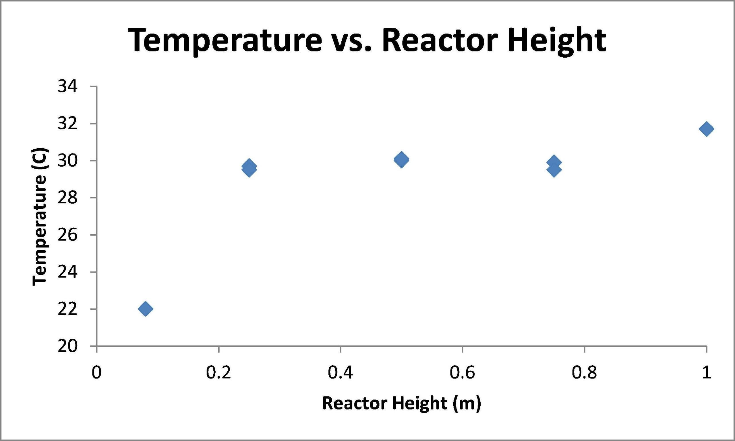
Temperature Profile

Slide 25
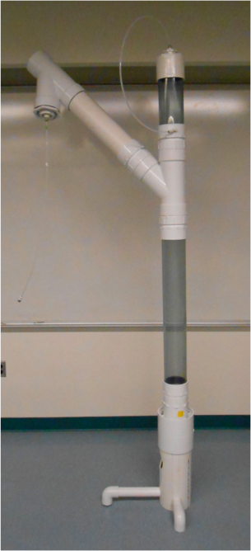
Large Reactor
Solution:
Substrate change?
Larger Reactor?
Also optimize
Methane Collection
Gas Tightness
Versatility
Temperature Change
Heated Room

Slide 26
Anaerobic Conclusions
Current Gas Measurement method is insufficient and inaccurate
Heating the reactors has not yet caused improvement in COD removal and gas production

Slide 27
Future Directions
Temp and COD removal/gas production relationships
Vary influent strength
Gas meter
Energy balance for production and use

Slide 28
Aerobic Treatment

Slide 29
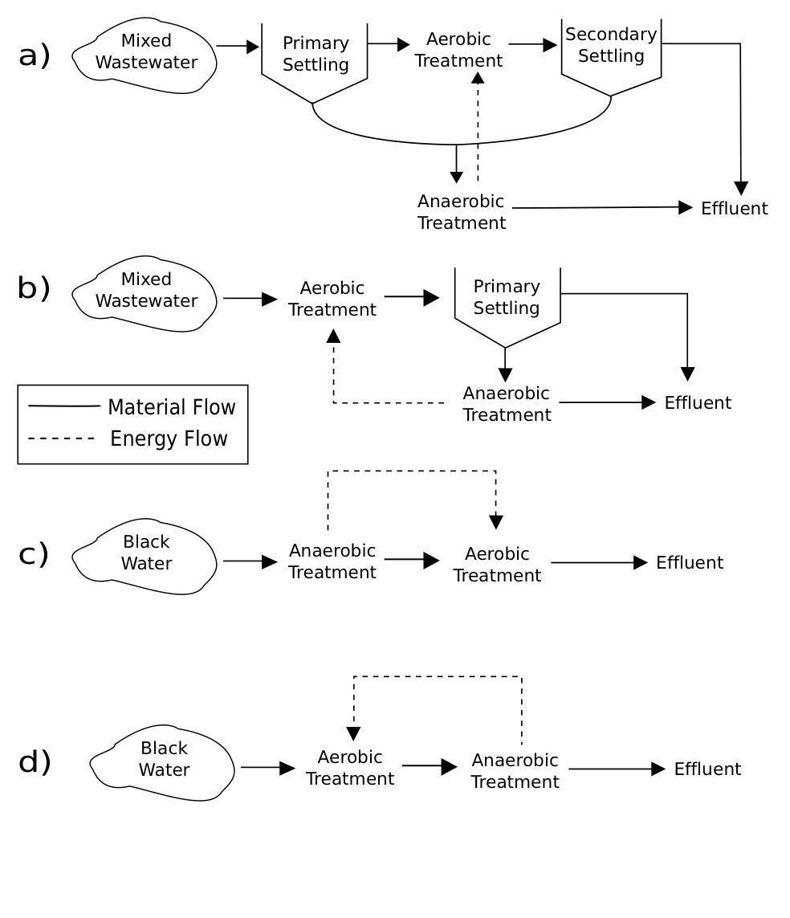
From anaerobic to aerobic

Slide 30
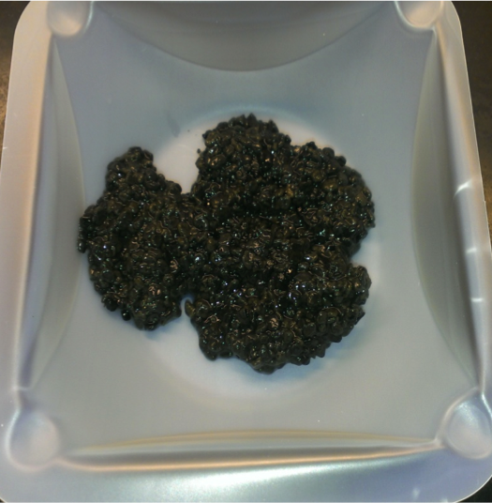
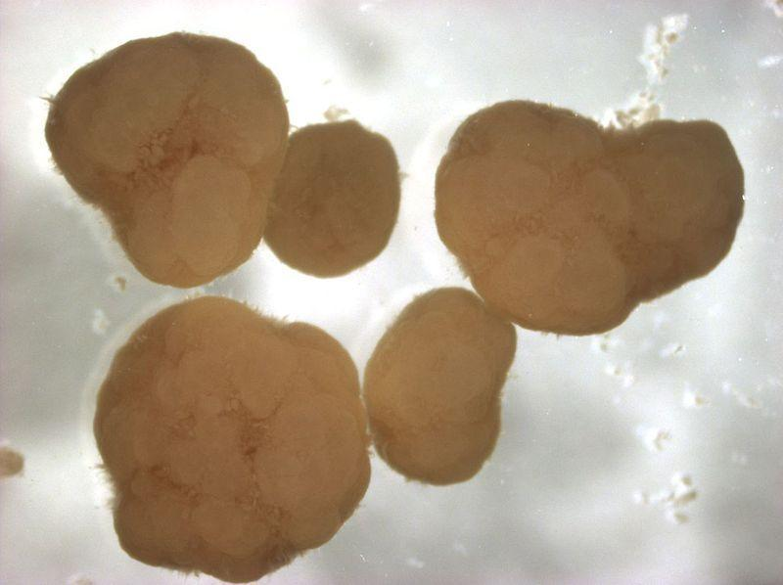
Still focusing on granules
5 cm
2 - 5 mm

Slide 31
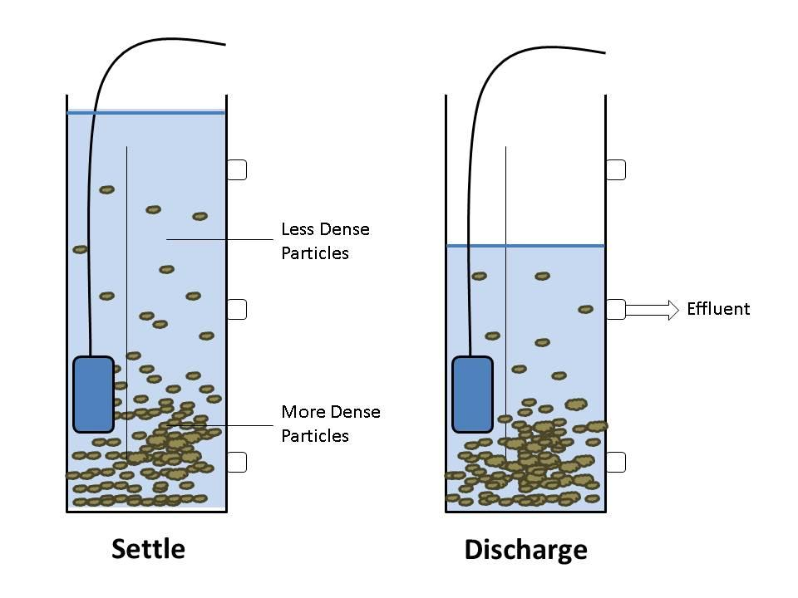
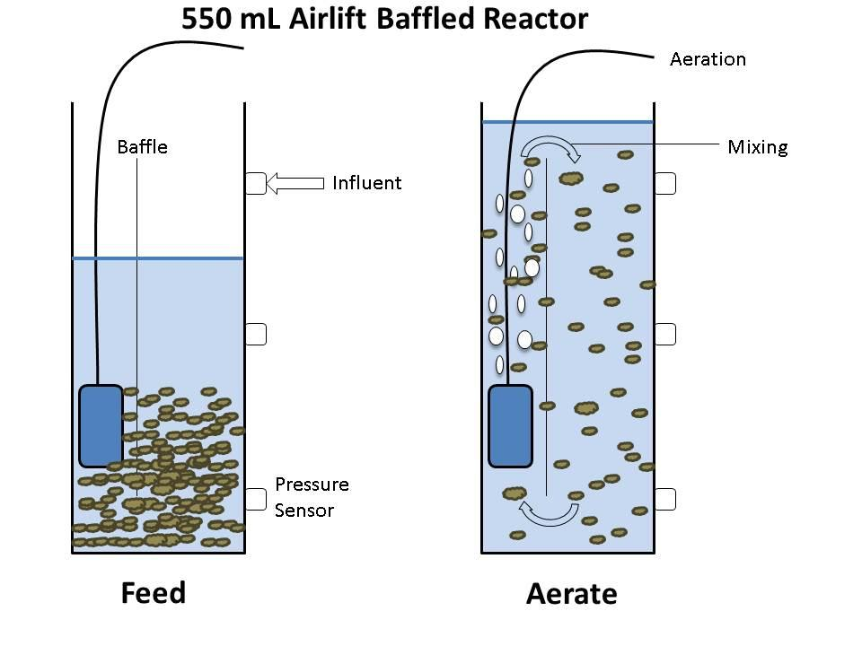
Granule Sequencing Batch Reactor (GSBR)
Operation States

Slide 32
Granule Sequencing Batch Reactor (GSBR)
Advantages
- Biomass retention
- No settling tank
- Simultaneous nitrification/ denitrification
Disadvantages
- Aeration requirement
- Difficult to cultivate granules
- Sequenced batch considerations

Slide 33
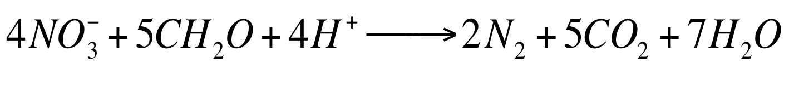
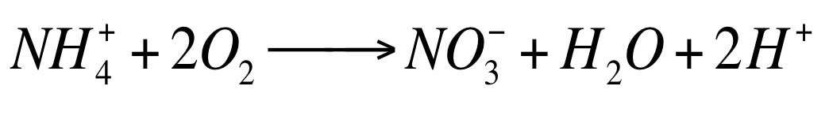
Simultaneous Nitrification and Denitrification (SND)
Anaerobic
High nitrogen removal at 20% O₂ saturation (de Kreuk et. al.)
Dependent upon presence of storage polymers
Aerobic

Slide 34
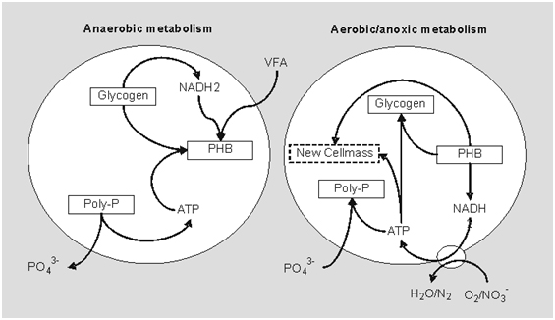
PAOs and GAOs
Acetate converted into storage polymers (PHB) in anaerobic stage
Phosphate taken up during aerobic stage to make poly-phosphates

Slide 35
Reactor Operation

Slide 36
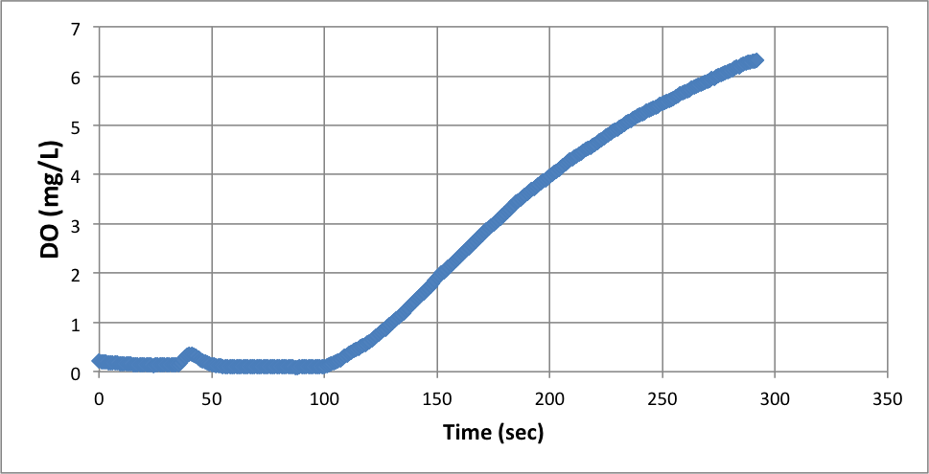
Determining aeration rate

Slide 37
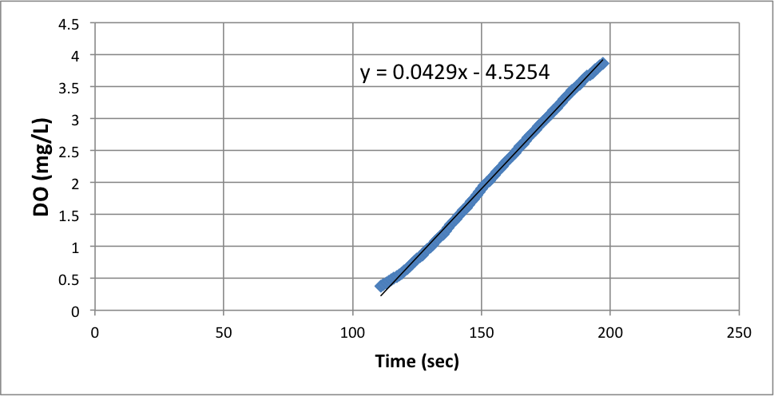
Determining aeration rate

Slide 38
Aeration - transfer efficiency
Flow Rate (uM air/s) | Flow Rate (g 0₂/day) | Oxygen Transfer Rate (mg/L-day) | OLR (mg/L-day) | O₂ Transfer Efficiency
100 | 58 | 3700 | 2500 | 3.5%
500 | 290 | 5900 |  | 1.1%
1000 | 580 | 9300 |  | 0.88%
2000 | 1160 | 9400 |  | 0.45%

Slide 39
Dissolved Oxygen Issues

Slide 40
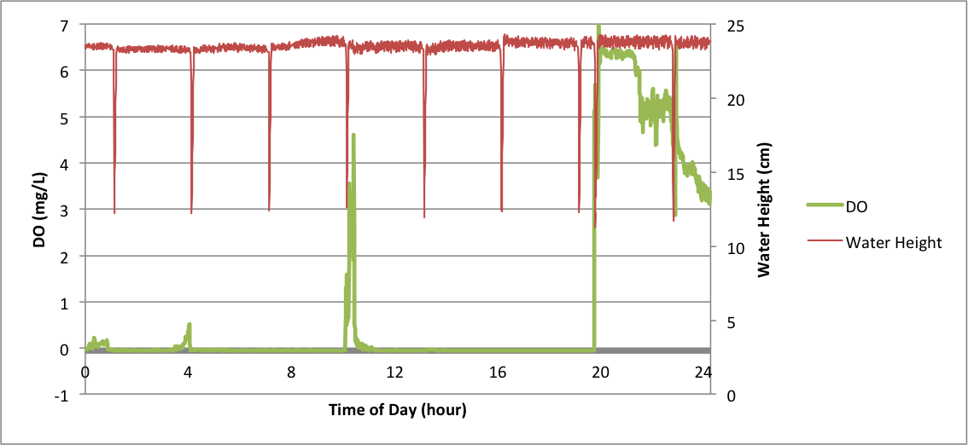

Slide 41
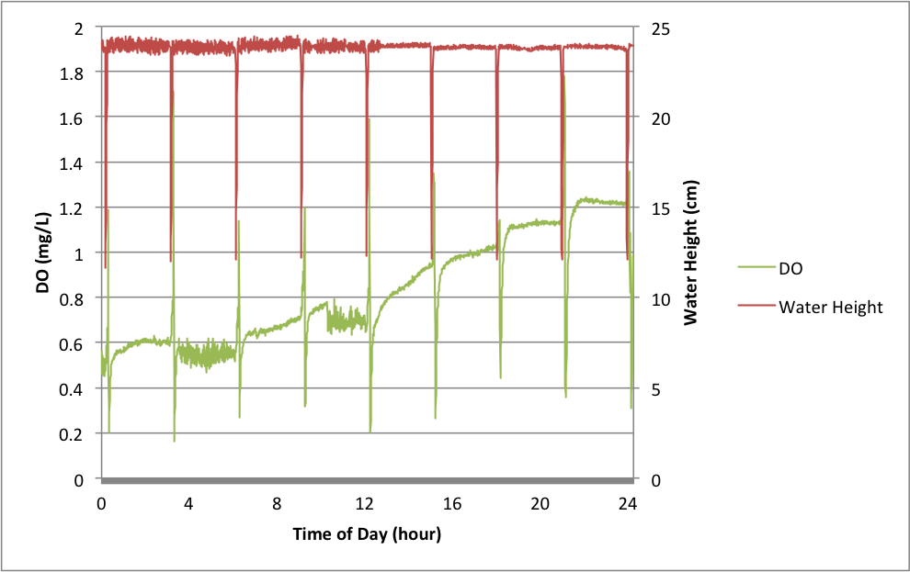

Slide 42
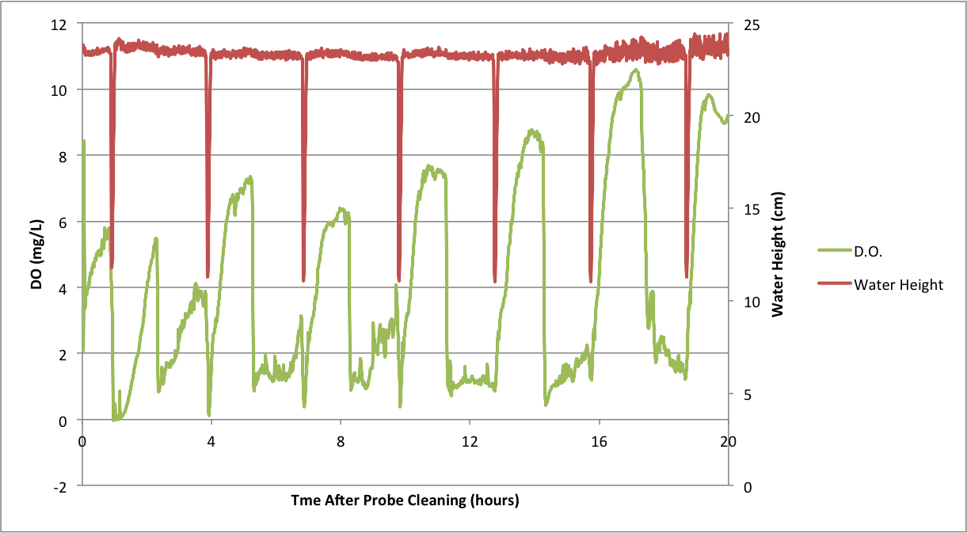
Aeration
Issues with monitoring DO

Slide 43
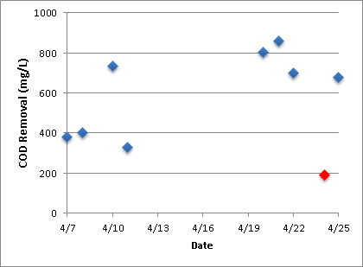
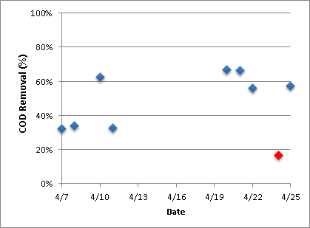
COD Removal
Average Influent Concentration: 1180.33 mg/L St Dev: 158.75 mg/L
 | COD Removal w/o Particulate | COD Removal w/ Particulate
4/28 | 82% | 26%

Slide 44
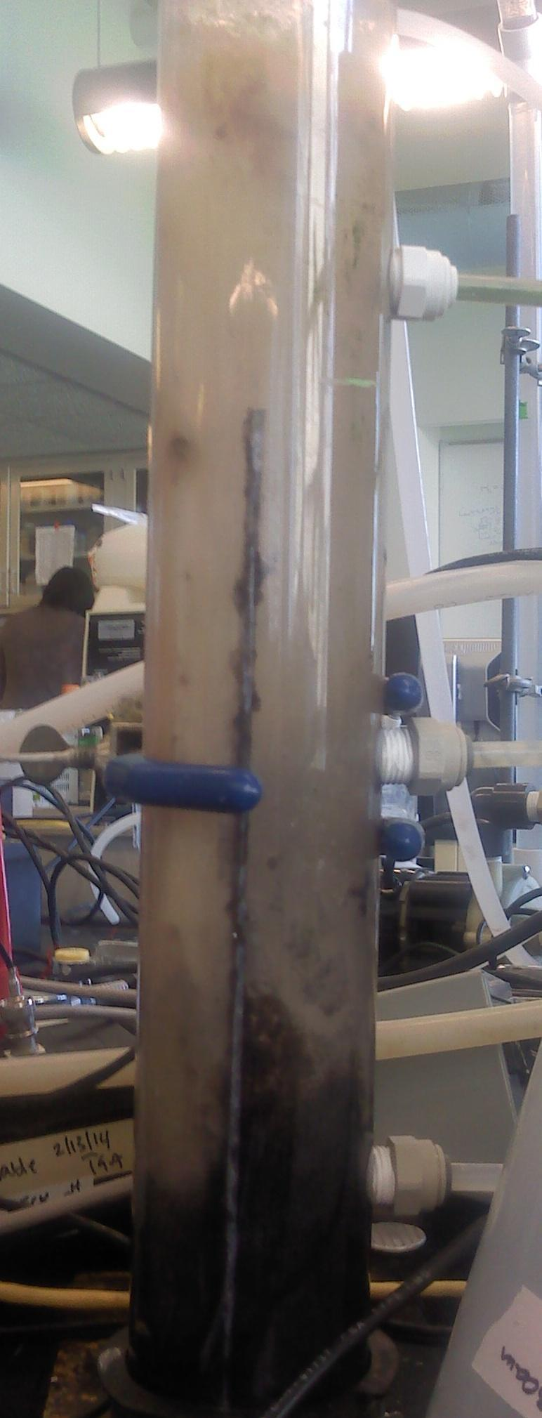
No Granules and Reactor Clogging
Flocculant growth prevented mixing
- insufficient mixing from baffle
- new design!

Slide 45
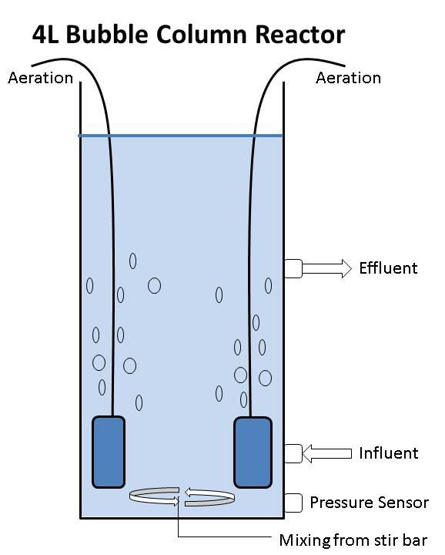
Larger Reactor
No baffle in current design - Bubble Column
Airlift reactor offers high shear zones which
increase granule stability
Bubble Column easier to implement
- longer startup time before granulation
Increase anaerobic time
- Increases granule stability, phosphate removal, simultaneous nitrification/denitrification (SND)
- 60 min anaerobic feed, aerobic period with O2 saturation of 20%

Slide 46
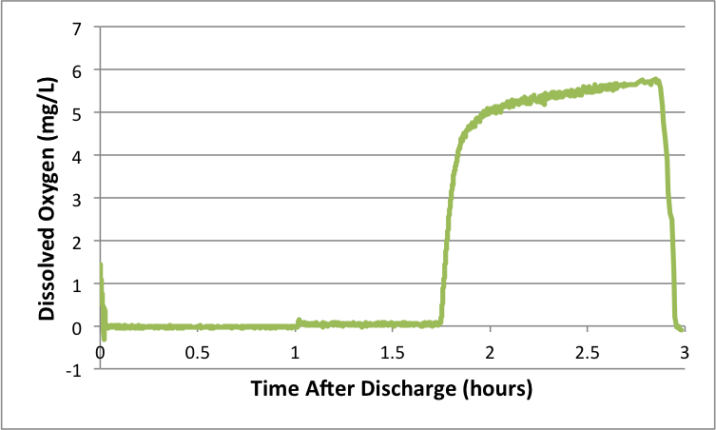
Large Reactor D.O.
Begin Aeration

Slide 47
Aerobic Conclusions
Granule cultivation is difficult
Reactor operation set up relatively easily
Insufficient mixing leads to flocculation, settling and clogging
Biomass growth on walls and aeration stones is excessive. Must be removed

Slide 48
Future Directions for Aerobic Treatment
(this summer)
Implement anaerobic idle time
Characterize granules
size, density (SVI)
locate PAOs (DAPI stain)
Monitor N, P removal
Change influent composition to better mimic wastewater
Construct more reactors to compare operation changes

